Slide 1

Twitter Big Data Project: Sentiment Analysis
Charles Ohiri
Sree Yadlapalli
Twitter Big Data Project Sentimental Analysis

Slide 2
Table of Contents
Introduction
Objective
Dataset Reasoning
Label Choice
Preprocessing Steps
ML Algorithm
QuickSIght Dashboard
Dashboard Findings

Slide 3

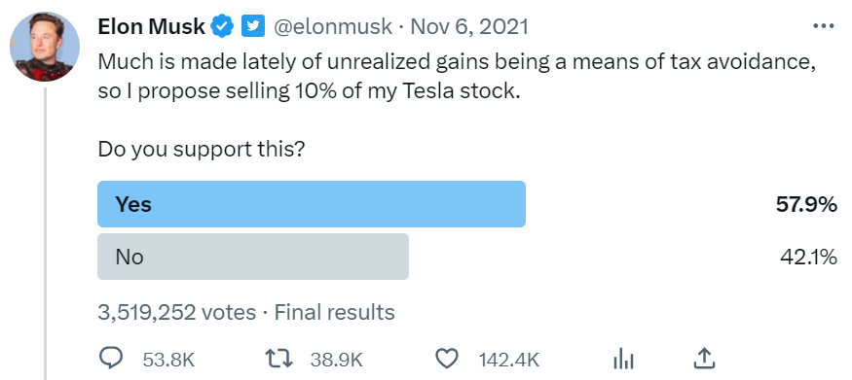
Introduction
A visionary entrepreneur and innovator who has disrupted industries ranging from electric cars to space exploration.
Most followed twitter account: 137.6M followers.

Slide 4
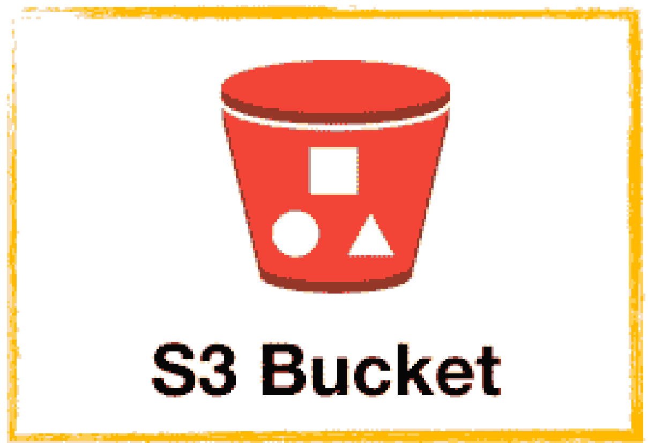



Objective
Launch a databricks notebook, work in distributed environment & build a PySpark Sentiment Analysis ML model
Write the sentiment predictions back in S3 buckets
Run MySQL queries using AWS Athena & build an interactive visual dashboard using Quick Sight to convey insights

Slide 5
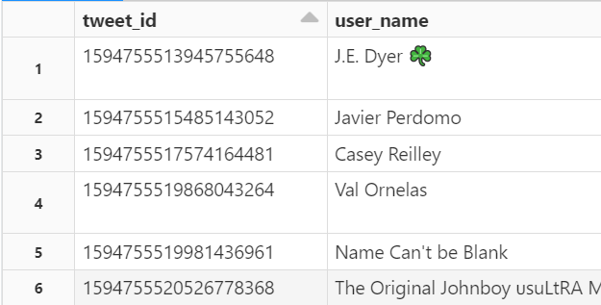
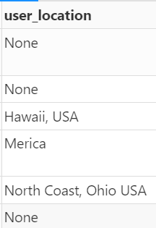
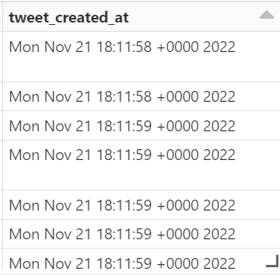
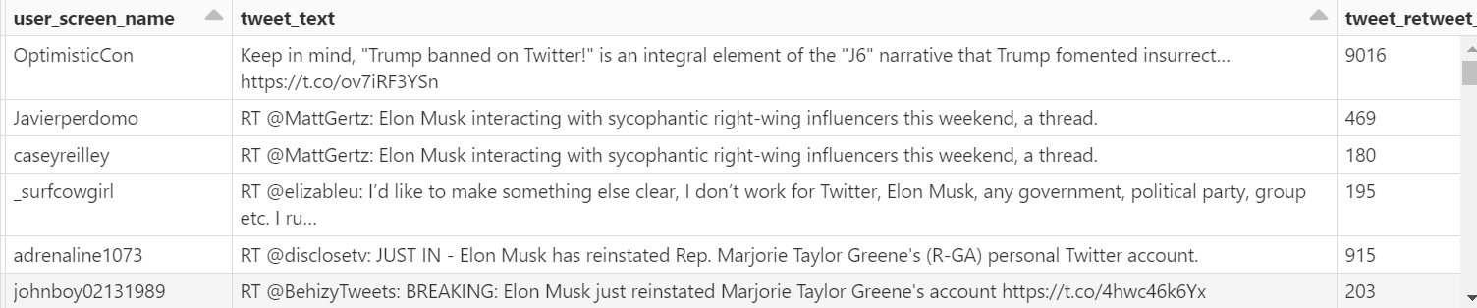
Data
328766 tweets were collected over 24 hours on 21st of November 2022

Slide 6

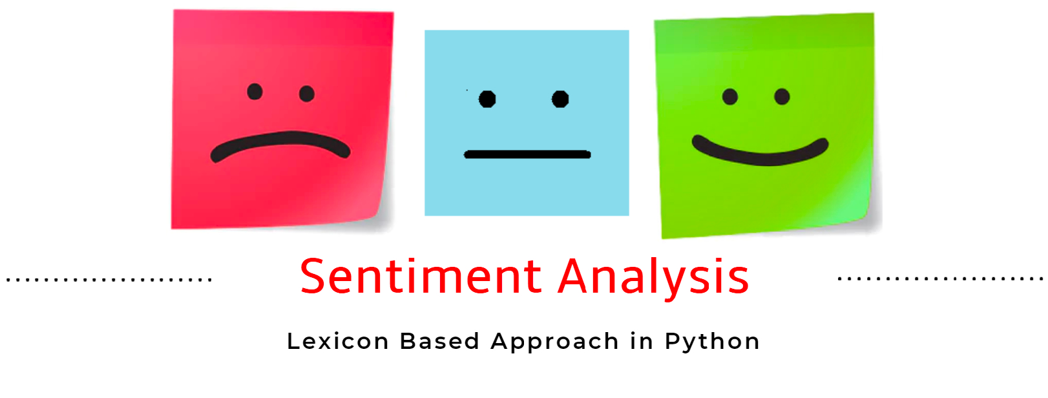
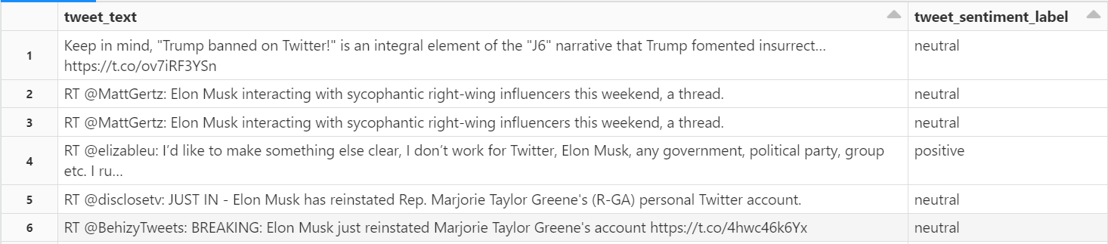
A lexicon-based method (TextBlob) was used to label tweets as having a positive, neutral or negative sentiment
Data Labeling

Slide 7
Data Preprocessing
‘Jenna went back to University
Lowercase & remove non-alphanumeric
jenna went back to university
Tokenise
’jenna’,’went’,’back’,’to’,’university’
Remove Stop Words
’jenna’,’went’,’university’
Stem/Lemmatise
’jenna’, ’go’, ’univers’
Remove duplicates/ missing values
Remove URLs
Remove special characters
Substituting multiple spaces with single space
Lowercase all text
Trim the leading/trailing whitespaces
Tokenization
Stop word removal
Countvectorizer & TF-IDF Vectorizer

Slide 8
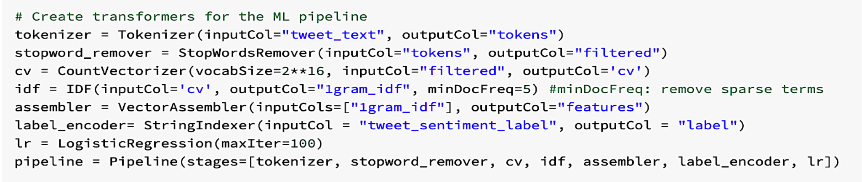
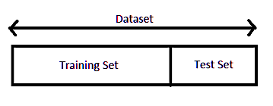
Machine Learning - Logistic Regression
Build a ML
pipeline of steps
Tune model parameters such as
‘N’-gram for TF-IDF vectorizers or
maxiter for Logistic Regression
Build predictions using
final chosen model
Fit pipeline on training set &
evaluate performance on testing set
Accuracy score of 0.9602 & F1 score of 0.96 were obtained for the final chosen model

Slide 9
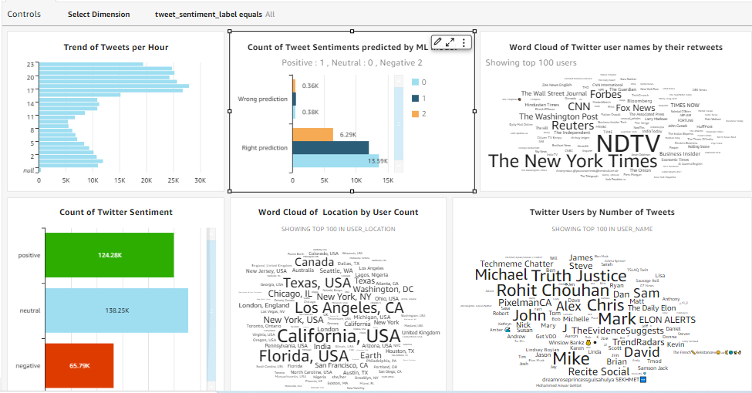
QuickSight Dashboard
Interactive dashboard to filter by predicted sentiment as well as by right/wrong predictions

Slide 10
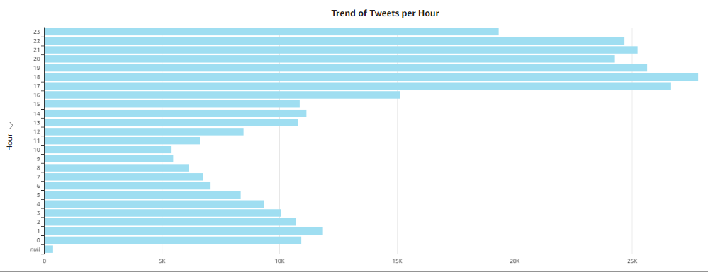
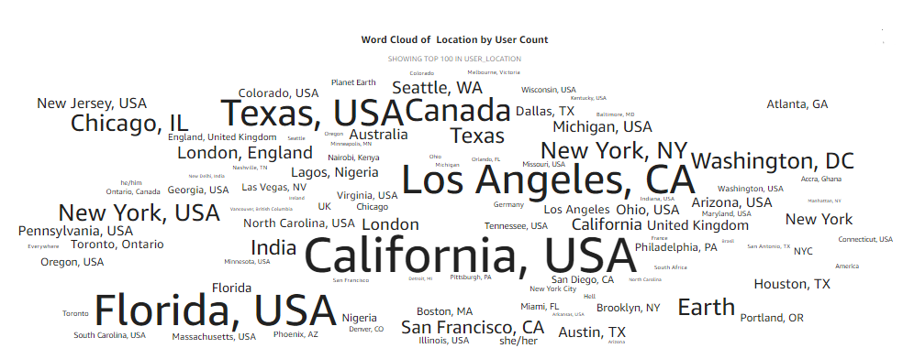
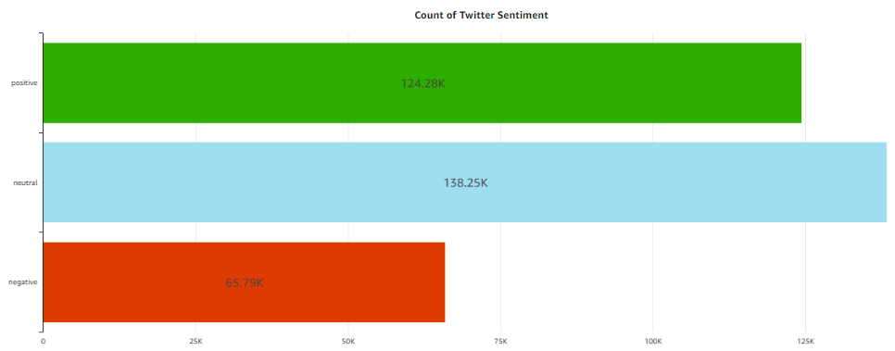
Dashboard Findings
Higher Volume of tweets during evenings
Most number of users are located on the west coast of USA.
Text Blob Segmentation
Positive : 37%
Negative : 20%
Neutral : 42%

Slide 11
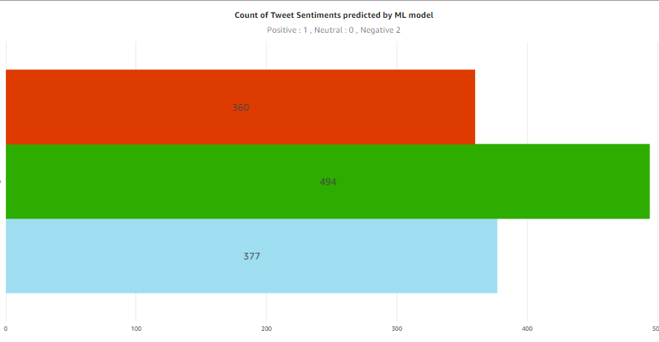
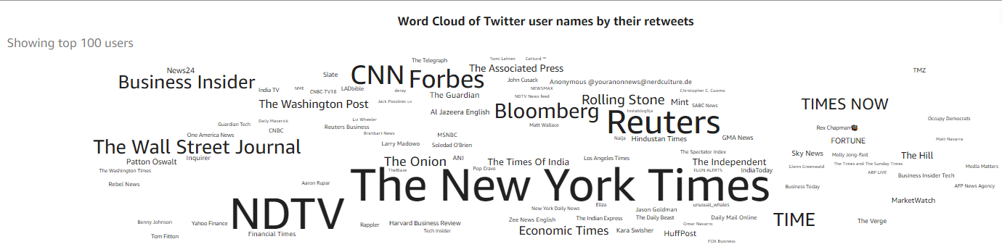
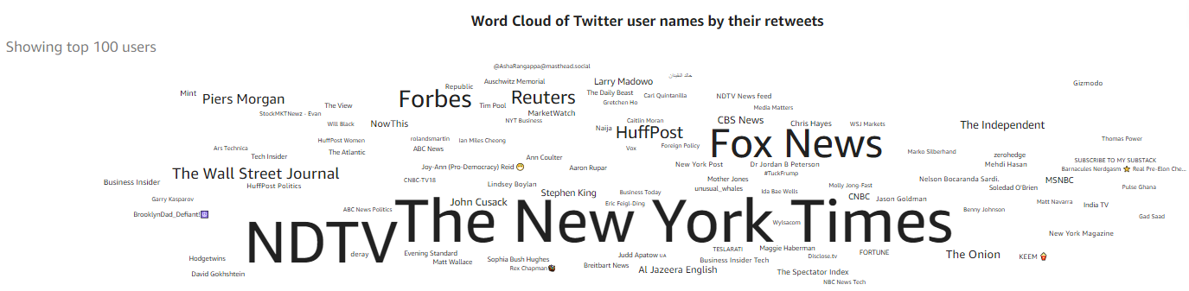
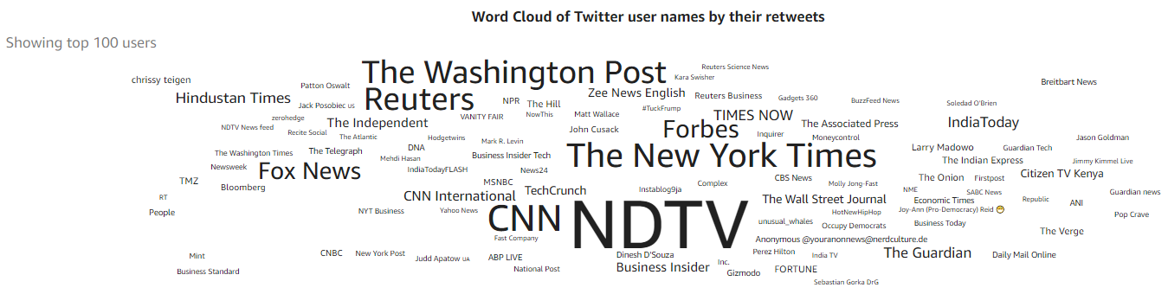
Dashboard Findings
Positive Sentiment
Negative
Positive
Neutral
Negative Sentiment
The model most notably incorrectly classifies ‘positive’ sentiments.
While there are no true distinction of users in sentiment distinction, it is evident that media houses have huge number of followers in an attempt to sway opinions of Elon.
Analysis of sentiments associated with their tweets can help learn about Elon’s brand impressions.
Neutral Sentiment

Slide 12
Challenges & Next Steps
Since only recent tweets were scrapped, reply_count,retweet_count & favorite_count were not useable.
Some of the attributes collected were not useable. Ex. ‘hashtags’.
TextBlob lexicon based approach may not be the best way to assign initial sentiments to tweets as it negates the emotion/ logic behind the text & focuses only on count of positive or negative words.
For next steps: project can be extended to build a real time analytical dashboard instead of static dashboard.
Other data labeling methods can be investigated to label the tweets more accurately.

